Slide 1
Project Jiak*Bot
*jiak - literal translation of the Hokkien verb “Eat”
Brijesh Gupta, Chan Wesley, Kuar Kah Ling, Tham Jun Quan, Thng Ren Jing Chris, Jiang Chen Yang Thomas

Slide 2
Overview
Inspired from a common problem working class adults in Singapore's Central Business District (CBD) faced - where and what to eat for lunch
Aims to suggest places to eat through a chatbot
Interactive user experience
More informed choice
Immediate responses
Built using Natural Language Processing (NLP) techniques

Slide 3

Overview
DATA
Scrape businesses data from Yelp including their reviews - Central Business District Area
LEVERAGING THE USE OF NLP TECHNIQUES
Where can I get chicken rice at raffles place
Jiakbot
Information
extraction
Parsing incl. Stmt / Question Classification
Finite State Machines
Generate Response
Display Answer
I like Hong Kong Soya Sauce Chicken Rice and Noodle …
Document Retrieval

Slide 4
How did we do it … exactly?
PARSING INCLUDING STATEMENT / QUESTION CLASSIFICATION
Tokenize & part-of-speech tagging using NLTK
Removed stopwords
Trained question classifier to predict the type of user input i.e. statement, question, rhetorical question using Yelp data and manually constructed training data.
the jiakbot’s NLP process
Document Retrieval
Parsing incl. Stmt / Question Classification
Information
extraction
Generate Response
Display Answer

Slide 5
How did we do it … exactly?
INFORMATION EXTRACTION
Tokenization
PoS Tagging
Parsing
NER
Where can I get Chicken Rice at Raffles Place
Segmentation and labelling at both the Token and Chunk levels
VB JJ NN IN NNS VBP
FP (Food Phrase) LP (Location Phrase)
Chicken Rice
Raffles Place
the jiakbot’s NLP process
Document Retrieval
Parsing incl. Stmt / Question Classification
Information
extraction
Generate Response
Display Answer

Slide 6
How did we do it … exactly?
DOCUMENT RETRIEVAL
Extract related data from database using SQL statements based on information extracted
Compare statements in database and user input using cosine similarity and returning a relevant statement with highest similarity
Passes output to generate a response
GENERATE RESPONSE
Construct response based on user’s input and document retrieved
the jiakbot’s NLP process
Document Retrieval
Parsing incl. Stmt / Question Classification
Information
extraction
Generate Response
Display Answer

Slide 7
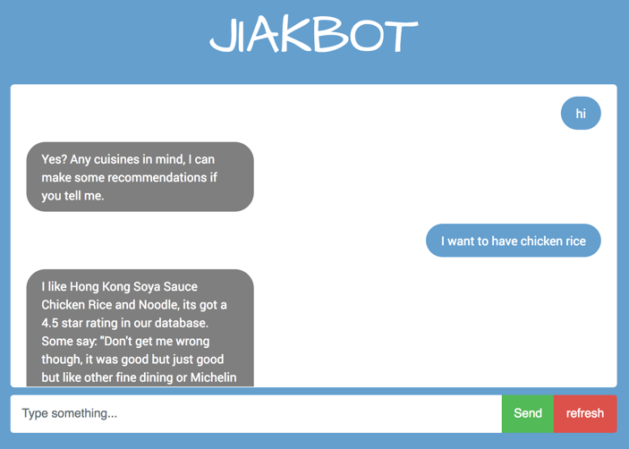
How did we do it … exactly?
DISPLAY ANSWER
the jiakbot’s NLP process
Document Retrieval
Parsing incl. Stmt / Question Classification
Information
extraction
Generate Response
Display Answer

Slide 8
How did we do it … exactly?
DISPLAY ANSWER
the jiakbot’s NLP process
Document Retrieval
Parsing incl. Stmt / Question Classification
Information
extraction
Generate Response
Display Answer

Slide 9
How did we do it … exactly?
TO REMEMBER THE CONVERSATION …
State Machine keeps track the context of a conversation and stores current state based on user inputs and Jiakbot’s responses
STATES
#1
Understood Nothing
#2
Understood Location
#3
Understood Food / Cuisine
#4
Provided No Result
#5
Provided Initial Result
#6
Provided Revised Result

Slide 10
Demo

Slide 11
Evaluation
Release JiakBot v1.0 for evaluation
Prepare a list of JiakBot and human responses for eliminating bias.
Compile the results (Inappropriate/Appropriate)
Identify weak areas of response (e.g. Greetings, Questions)
Identify most asked questions and keywords
Improve Jiakbot’s vocaburary & logical design based on feedback

Slide 12
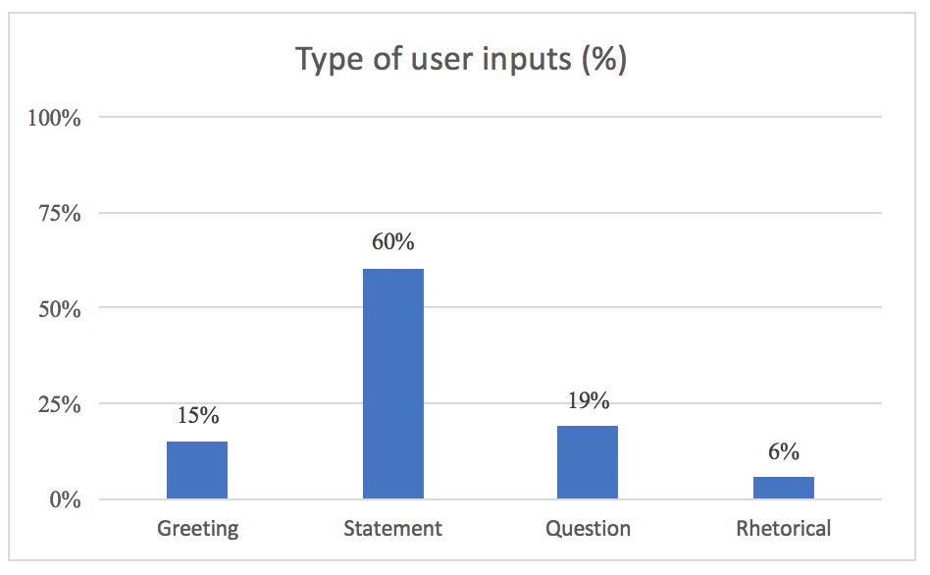
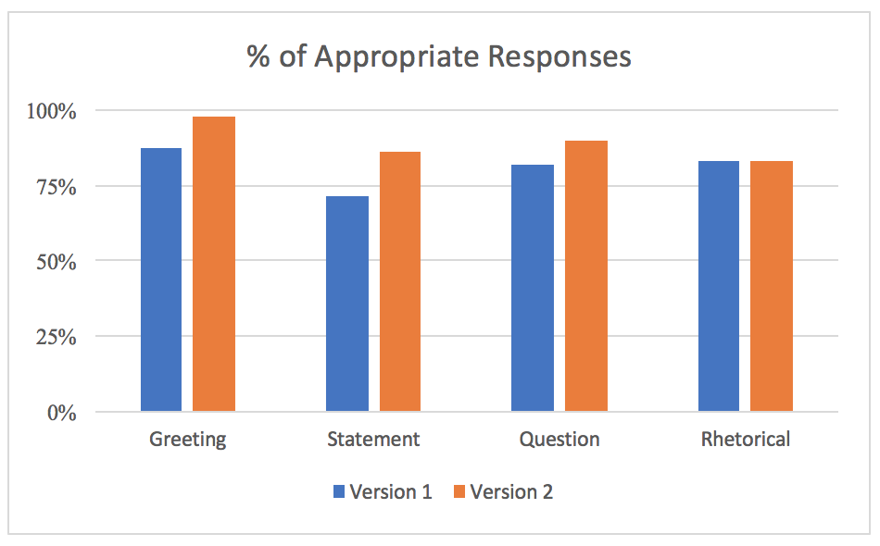
Evaluation
Results based on independent evaluation by 6 raters with fixed set of statements for the bot to respond to.
Improvement seen in all areas except rhetorical questions (primarily due to the classifier accuracy).

Slide 13

Challenges Faced
Getting distinct topics using out-of-the-box topic modeling techniques such as LDA
Highly susceptible to stopwords and words distribution which in case of reviews are highly right skewed
Need to explore further if complementing it with PoS tags or custom features extraction will work better
Understanding user inputs
Spelling errors, different spellings of different cuisines

Slide 14

Challenges Faced
Generating an appropriate response based on the context
NLTK is not strong in recognising food and/or places in Singapore
Lack of training data for question classifier
Lack of time to conduct JiakBot use case trials and collect sufficient data for further refinement of the bot
Putting everything together
Need to think about how individual components work together

Slide 15

Key Takeaways
Real text mining problems typically involves putting several techniques together.
Leverage on existing works and findings - For example, someone else built chatbots and done research on question classification for tweets
Appropriate database is key - For example, food reviews for food recommendations
Generic bag-of-words models are good as the first cut - For better results, some custom feature extraction is required
Conversations are subjective and cannot follow traditional evaluation metrics of accuracy, recall and precision
Improvement through feedback is an iterative process

Slide 16
Q + A

